Slide 1
Word Wealth Unit 6
Adjectives

Slide 2
Copious
Abundant, Plentiful
Related Words:
Ample: More than enough
Profuse: lavish to the point of excess

Slide 3
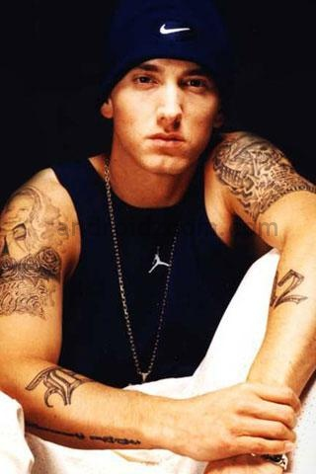
Eminent
Outstanding, prominent
Related Words:
Renowned: widely known
Celebrated: widely praised
Notorious: widely noted or noticed
*Synonym-Distinguished

Slide 4
Frugal
Sparing, thrifty, economical
*Antonym-Prodigal: wasteful, extravagant

Slide 5
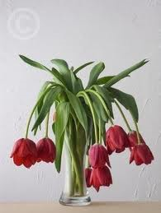
Languid
Drooping, listless
Related Words:
Lassitude: a feeling of weariness or weakness

Slide 6
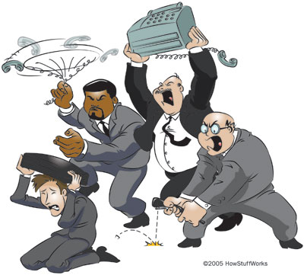
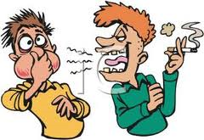
Hostile
Unfriendly, warlike
Related Words:
Adverse: turned against or opposing
Averse: unfavorable to
Antagonistic: struggling against

Slide 7
Laudable
Praiseworthy, commendable

Slide 8
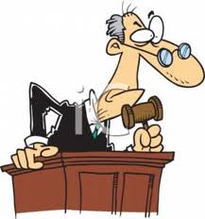
Lenient
Mild, merciful

Slide 9
Luminous
Glowing, giving off light
Related Words:
Luminescent: letters or figures that glow in the dark

Slide 10
Nocturnal
Occurring at night

Slide 11
Oblique
Slanting, indirect
Related Words:
Devious: tricky, roundabout, intended to mislead

Slide 12
Obnoxious
Offensive, hateful
Related words:
Noxious: poisonous, harmful
*Synonym: Odious (stronger word)

Slide 13
Obtrusive
Pushing, demanding attention, showy
Related Words :
Officious: refers specifically to a person inclined to interfere when not wanted

Slide 14
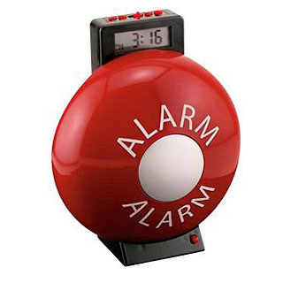
Perpetual
Unending, lasting forever
Related Words:
Incessant: ceaseless
Interminable: seemingly endless
Eternal: literally means forever

Slide 15
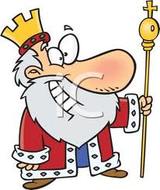
Regal
Royal, notably excellent
Related Words:
Regalia: emblems and decorations of royalty

Slide 16
Vagrant
Roaming, wandering, or wayward
Related Words:
(Nomad)Nomadic: having no fixed home
Itinerant: workers who travel from place to place

Slide 17
Vehement
Violent, passionate

Slide 18
Vindictive
Vengeful, seeking revenge
Related Words:
Resentment: slow-burning anger
Rancor: bitter hatred, ill will

Slide 19
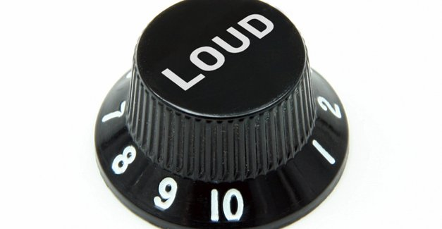
Vociferous
Vocally noisy, clamorous, loudly insistent
Related Words:
Obstreperous: unruly noise
Boisterous: unrestrained and confused noise

Slide 20
Vulnerable
Susceptible to injury or attack

Slide 21
Zealous
Very active, eager, devoted
Related Words:
Fanatic: overzealous person
Bigot: zealous in a blind or intolerant way

